Slide 1
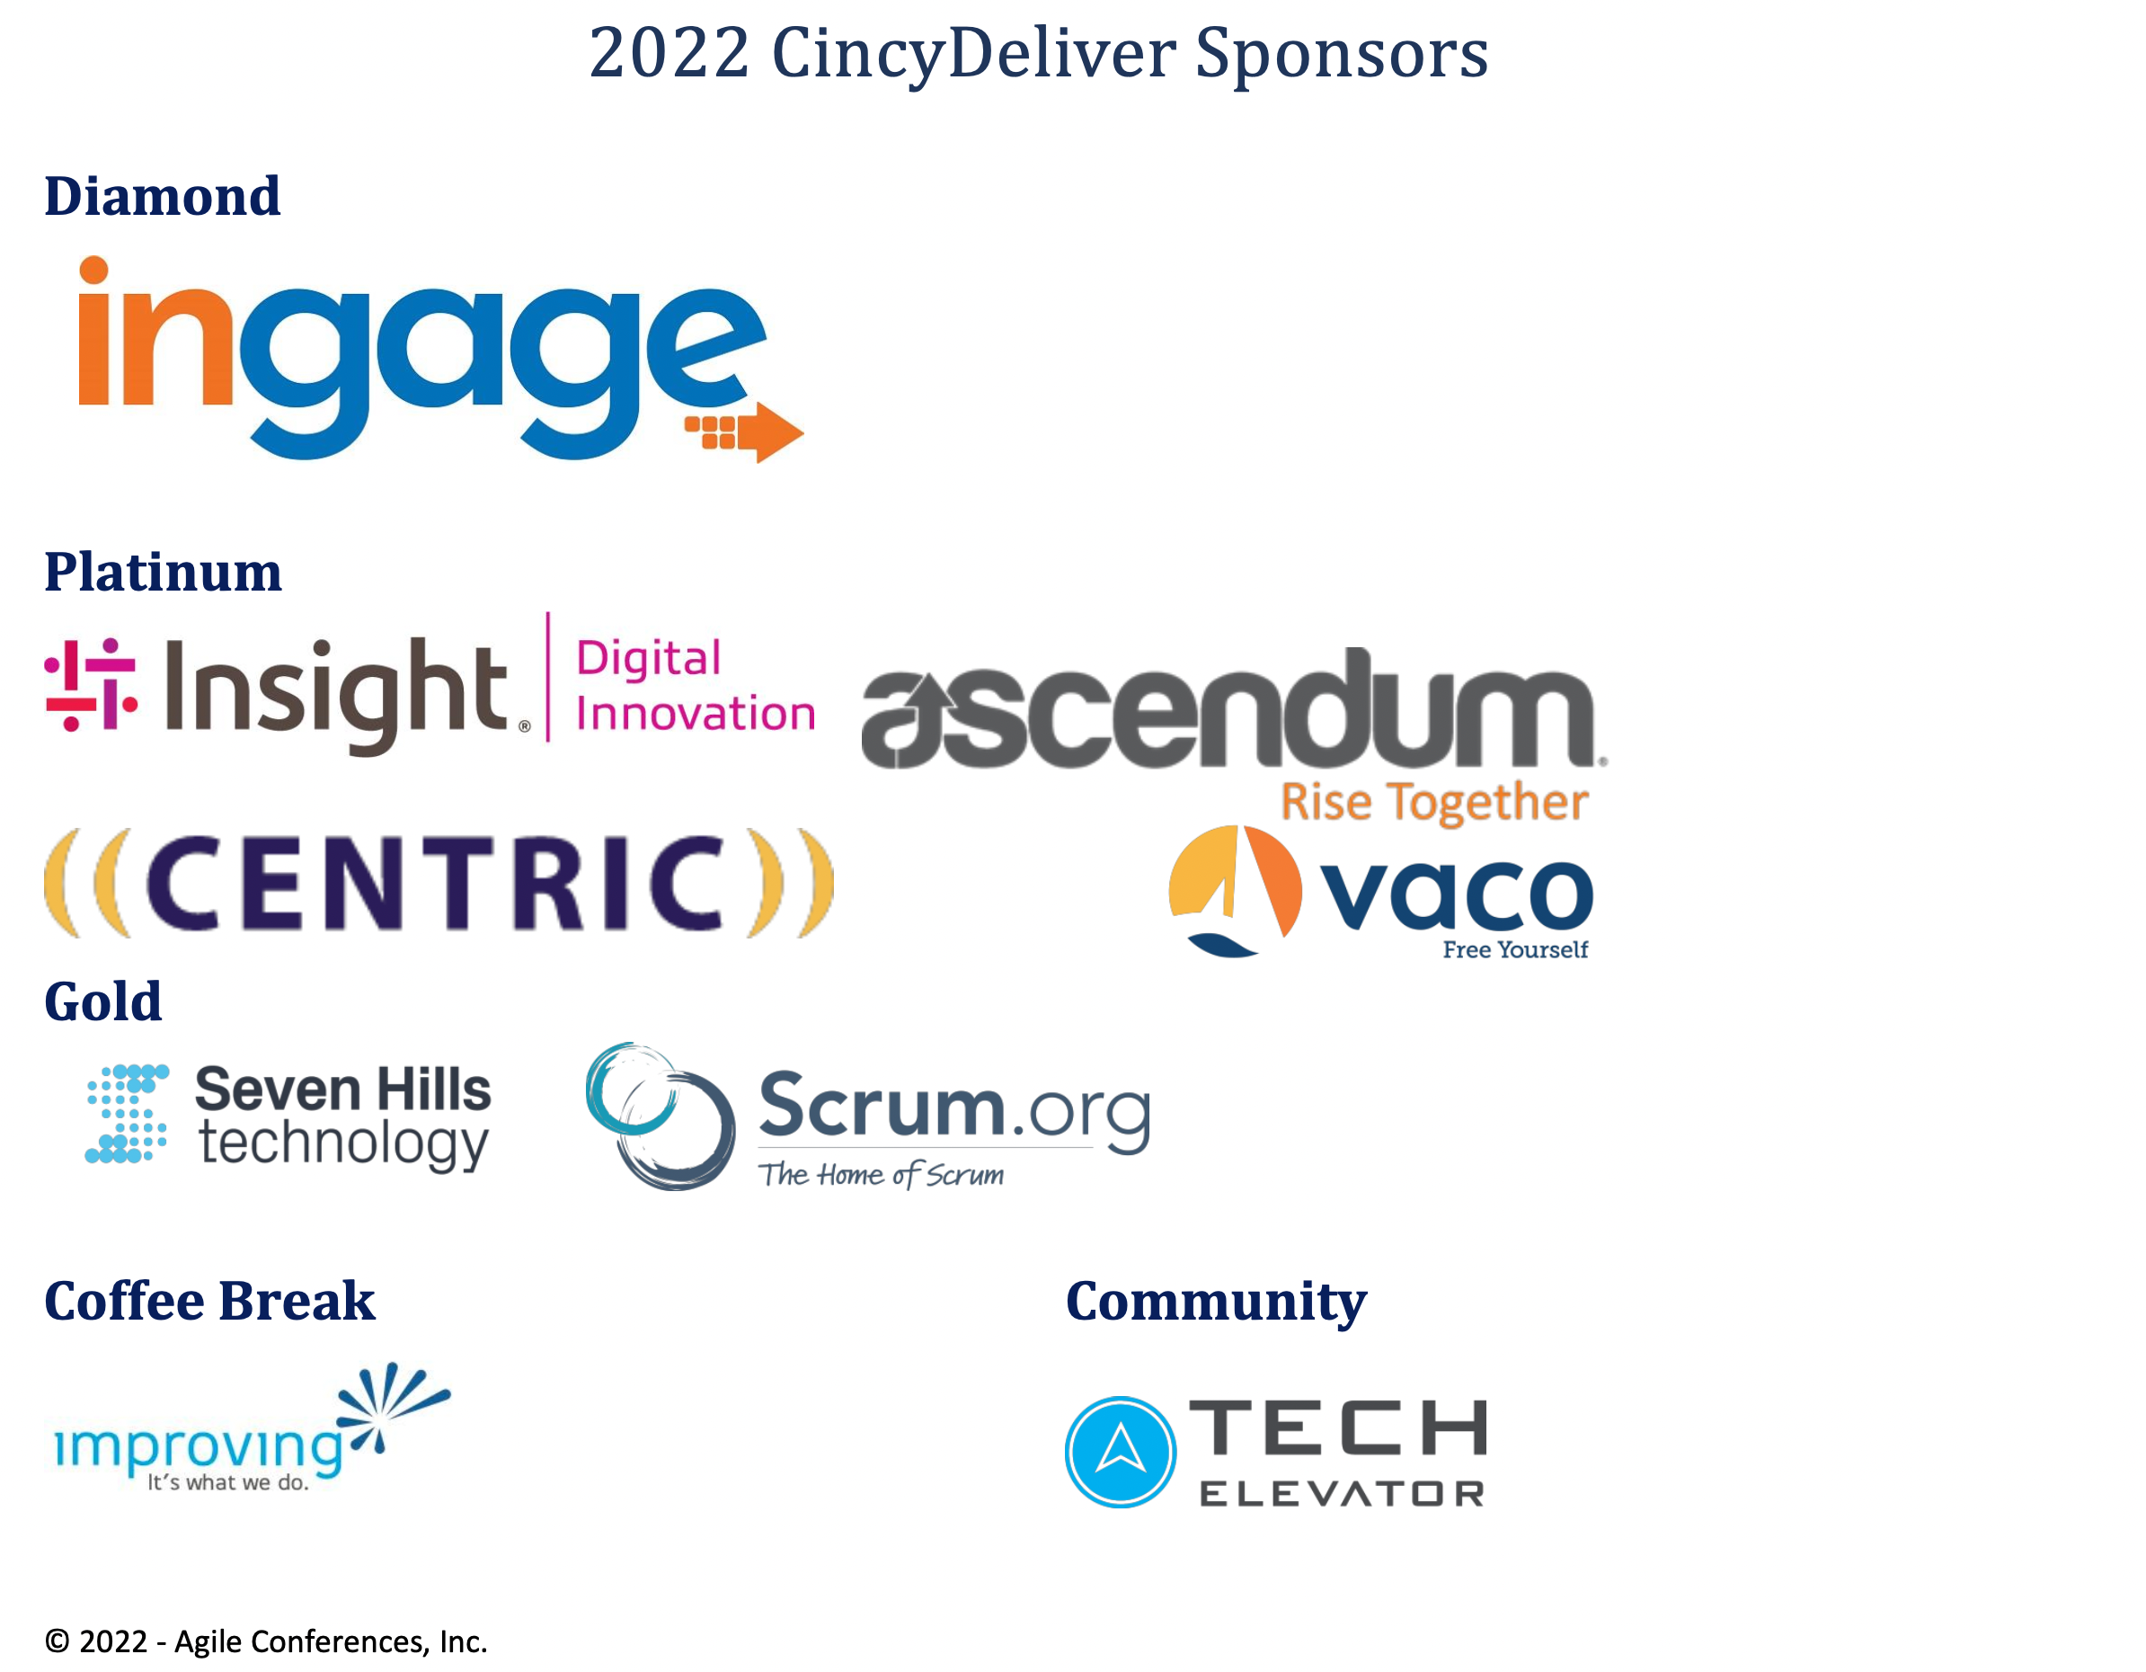

Slide 2

All Systems Go:
Event-Driven Architecture, Micro-Services, and the Cloud
@ShawnWallace

Slide 3
Event-driven architectures are a versatile approach to designing and integrating complex software systems. Event-driven architecture is not a new concept, but as more organizations evolve and are open to move more features to the cloud, this approach to system design has become appropriate in more situations and is worth a fresh look. In this session we'll talk about orchestrating enterprise workflows in the cloud using Event-driven approaches, how to build new services to participate, and design patterns for integrating existing/legacy applications.
We'll also hit a few topics including:
Eventually consistent data and how to keep your data warehouse team happy
Command-Query Response Segregation
The Mediator design pattern
Event Sourcing

Slide 4
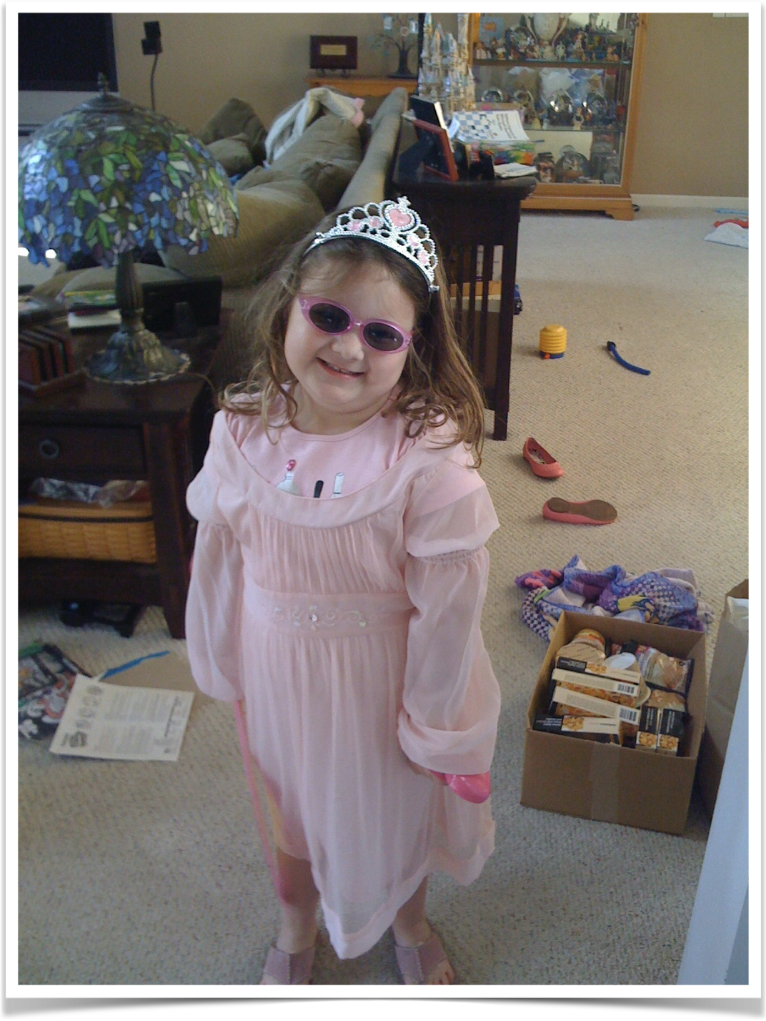
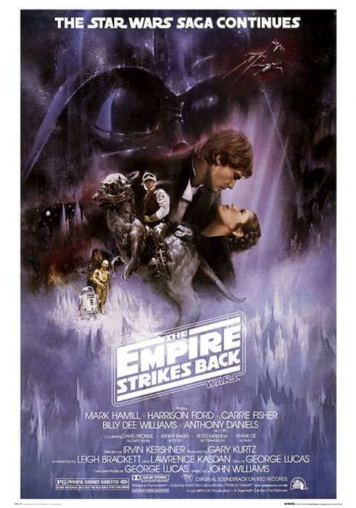
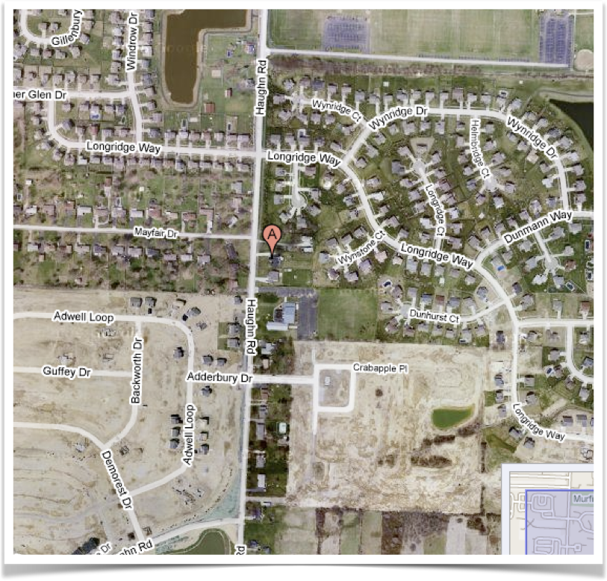

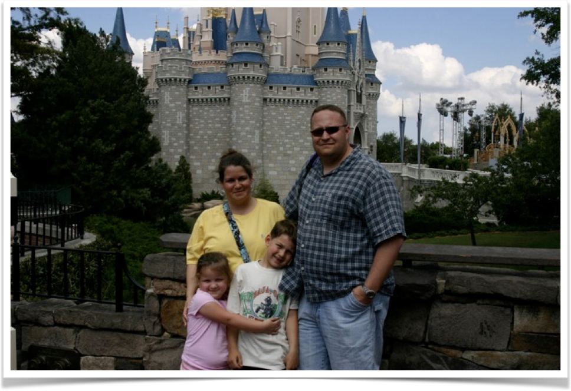


I’m Shawn
Favorite Movie
My Son
My Daughter
My Family
I live here
I a Marine Vet
My Favorite Team
Where I work
Notes:
A few things about me.

Slide 5
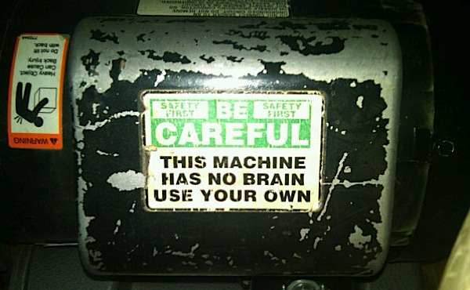
Notes:
These come from my experiences and research. You might have different opinions or I might just be wrong about some things.
How I came to go down this path.
looking for ways to orchestrate business processes in an enterprise without requiring specialized skillsets

Slide 6

A word about ‘productizing’ patterns and practices
Notes:
I’m going to use terms like
SOA
DEVOPS
ESB

Slide 7
The Great Debate…
http://martinfowler.com/articles/dont-start-monolith.html
Monolith First?
Micro services First?
http://martinfowler.com/bliki/MonolithFirst.html
Notes:
It’s very popular to say “build a monolith”…

Slide 8
Monolithic
Orders
Invoicing
Inventory
Logging
Warehouse
Profiles
Notes:
This is how a monolith is built
How agile killled this approach

Slide 9
A problem with ‘Monolith First’
A product of our agile approach to our projects…smaller features finished earlier.
The goal is to deploy more often…this is hard.
One solution is to have smaller applications.
Notes:
While our features are smaller, the testing effort hasn’t changed.
We can rely some on test automation, but even these test suites can get inflated.
I’m not trying to enter the debate.

Slide 10
Monolithic
Orders
Invoicing
Inventory
Logging
Warehouse
Profiles
Notes:
This is how a monolith is built

Slide 11
Why NOT a Monolith?
A product of our agile approach to our projects…smaller features finished earlier.
Our business users frequently need to move faster than we can support.
The goal is to deploy more often…this often is hard with monoliths.
One solution is to have smaller (and smaller) applications.
Notes:
While our features are smaller, the testing effort hasn’t changed.
We can rely some on test automation, but even these test suites can get inflated.
I’m not trying to enter the debate.

Slide 12
SOA
Orders
Invoicing
Inventory
Logging
Profiles
Warehouse
Notes:
Here is what we have done…

Slide 13
SOA
Orders
Invoicing
Inventory
Logging
Profiles
Warehouse
Tightly Coupled
Notes:
How do you do system-wide logging?
Mention ESB bus (expensive, requires specialized skillsets, did I say expensive).
Discoverablitiity
Addressing
Hard to change/test/deploy
Direct Dependencies are a problem

Slide 14
SOA with Enterprise Service Bus
Orders
Invoicing
Inventory
Enterprise Service Bus
Logging
Profiles
Warehouse
STILL Tightly Coupled
Notes:
How do you do system-wide logging?
Mention ESB bus (expensive, requires specialized skillsets, did I say expensive).
Going in the right direction

Slide 15
“The Role of the ESB still has its place — now in the form of a modern scalable message queue”
Source: Reactive Micoservices Architecture (Design Principles for Distributed Systems p. 34
Jonas Bonér

Slide 16
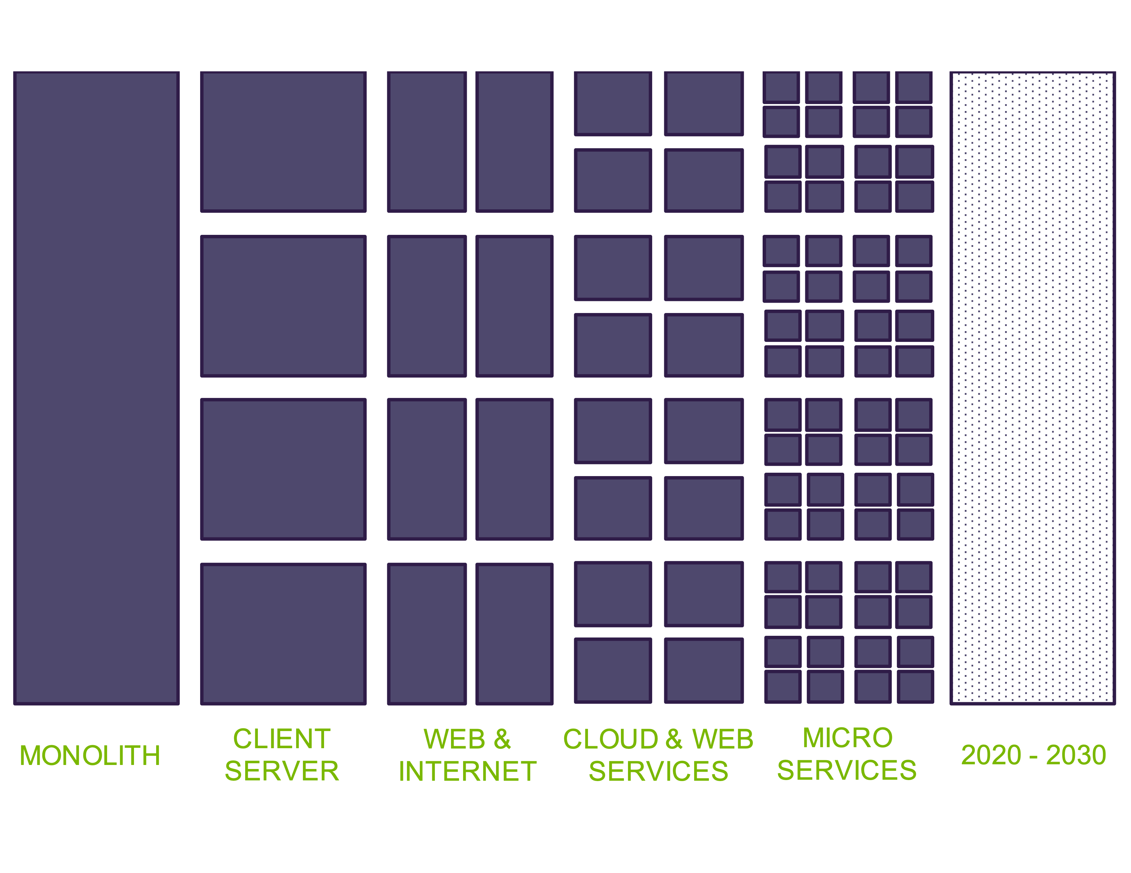
Notes:
You are probably somewhere on this continuum. Or maybe several places on it…
We are ALL cloud.

Slide 17
What are Microservices
Independently testable/deployable
Operate in isolation (loosely coupled)
Maintains own state
Asynchronous external interactions that favor message passing
Notes:
No really consensus…

Slide 18
Important Early Decisions
Embrace Asynchronous Interactions
Communication Pattern
Logging Infrastructure
Notes:
don’t be too dogmatic

Slide 19
Important Early Decisions
Embrace it
The basic thesis of this article is that organizations which design systems (in the broad sense used here) are constrained to produce designs which are copies of the communication structures of these organizations.
--- Melvin Conway
Notes:
Do our software systems do not create friction in the organization
Embrace it…

Slide 20
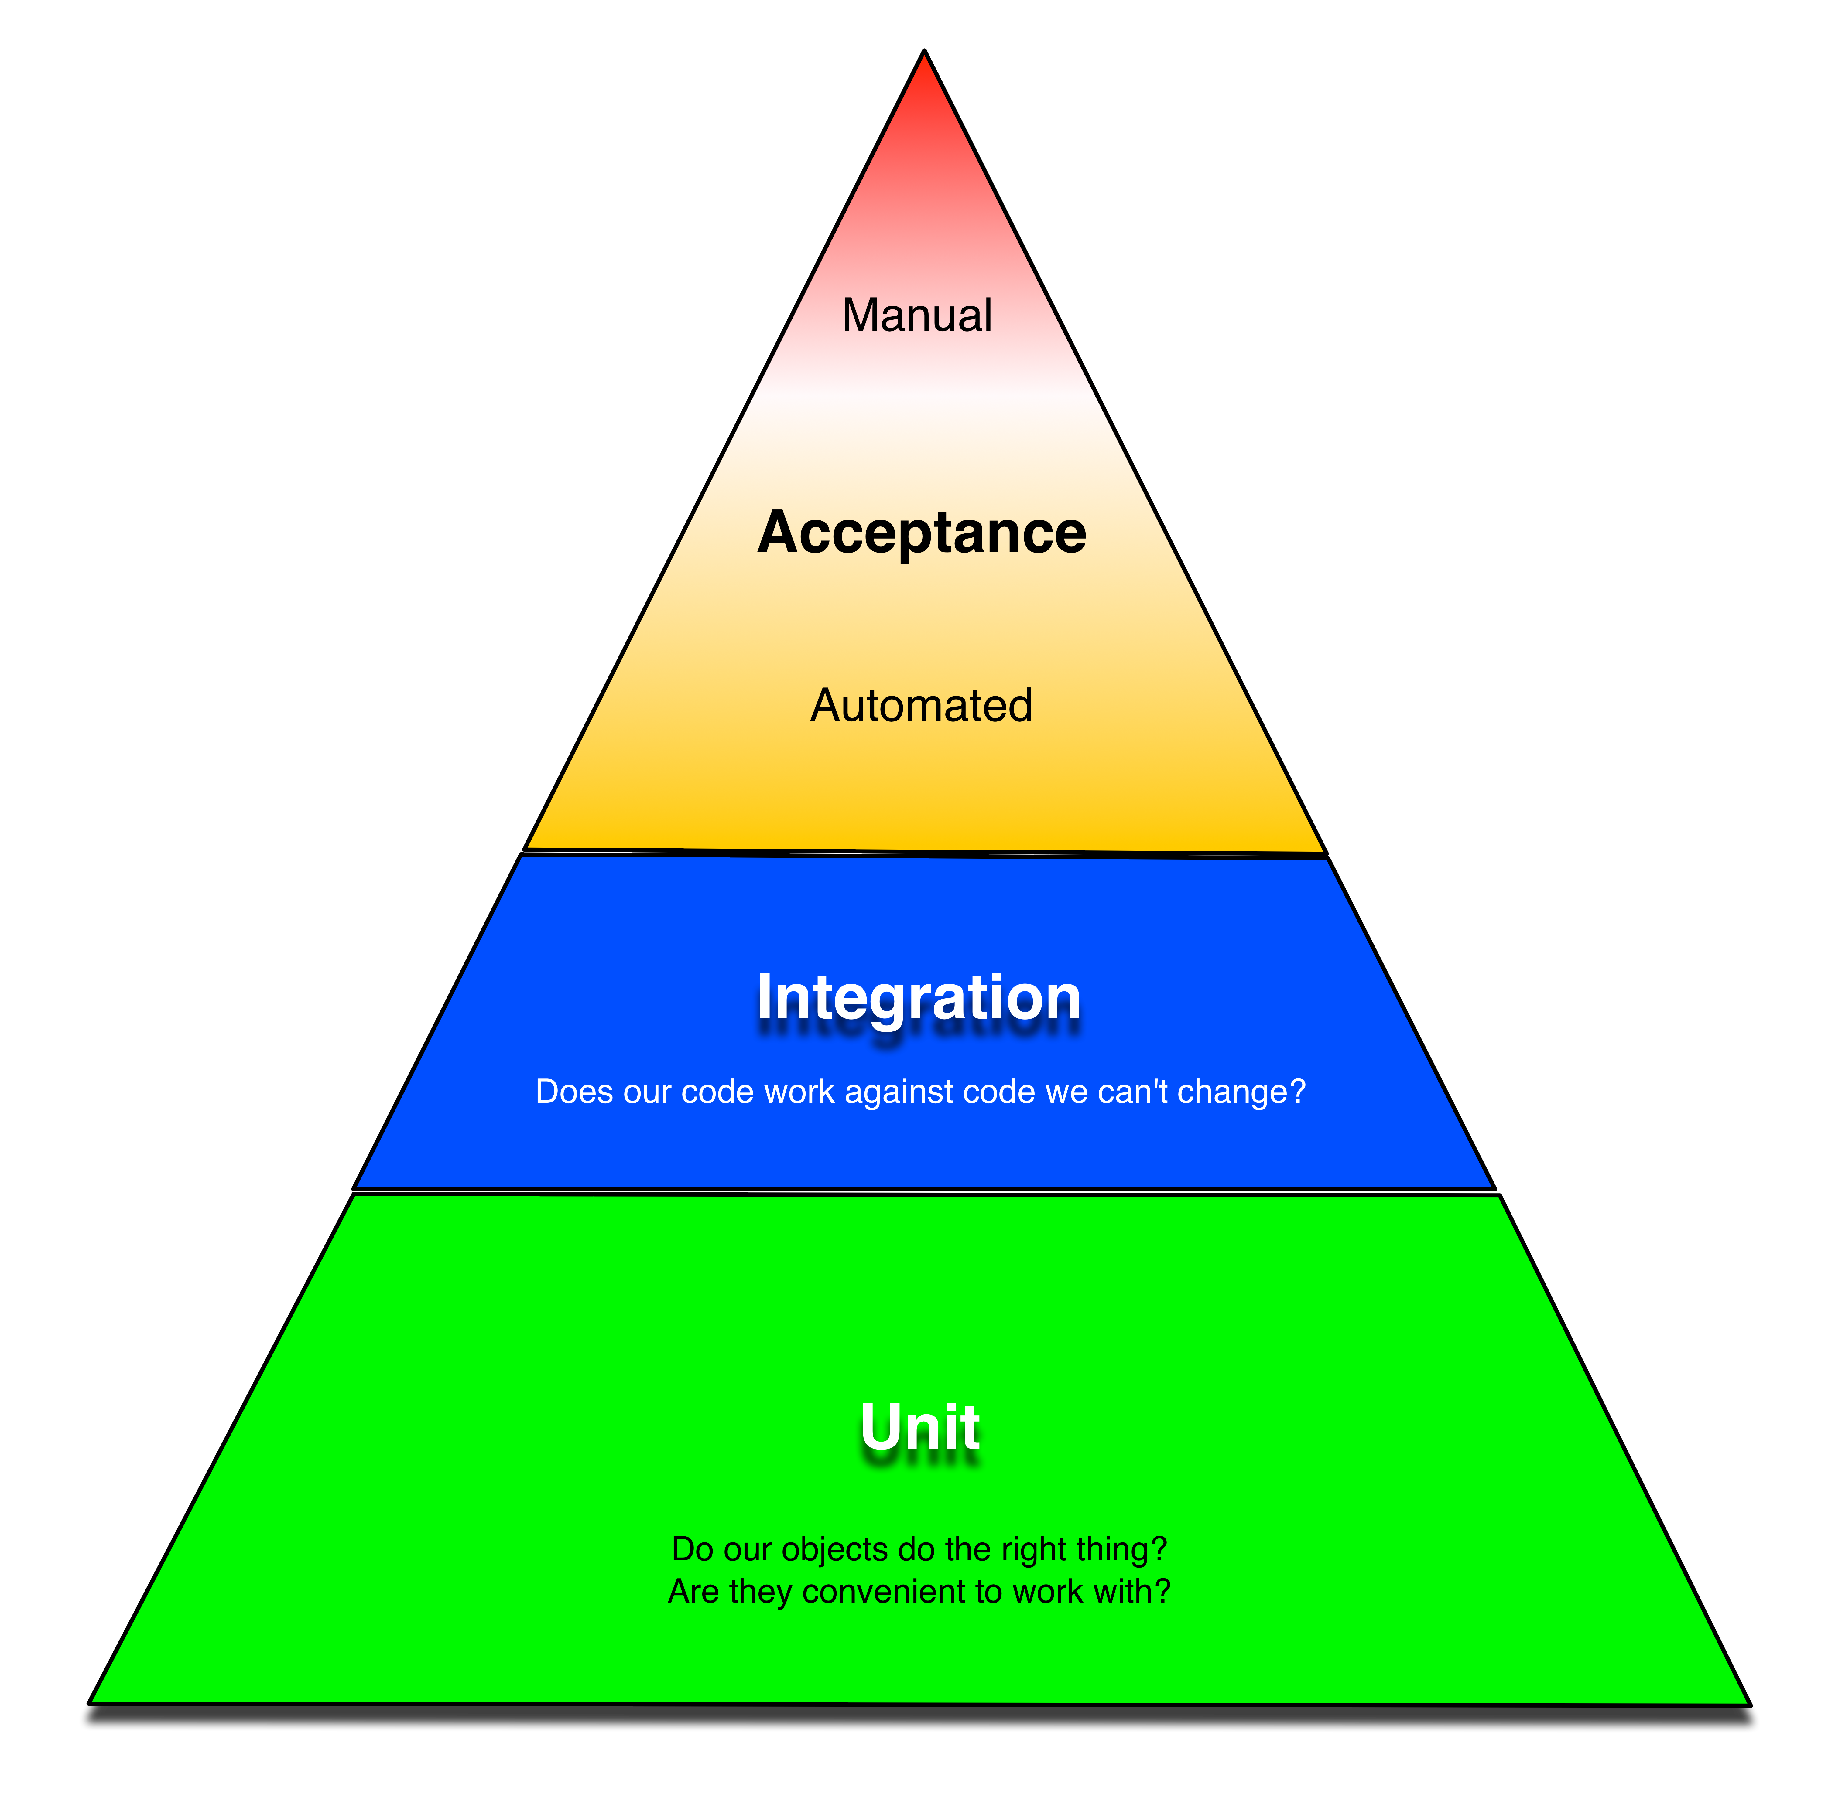
Be easy to test…
…so that you do.
Important Early Decisions
Notes:
Add a new subsystem and start consuming events that are already in the system

Slide 21
ReST is NOT your friend

Slide 22
Code Reuse is Overrated

Slide 23
Don’t I need Transactions?

Slide 24
Should Client Communication Still be Asynchronous?
Notes:
Clients often assume synchronous communication.
CQRS

Slide 25
We have to think about our data differently
Notes:
Clients often assume synchronous communication.
CQRS

Slide 26
We have to think about our data differently
Taking data from being OFFLINE to ONLINE
Moved from “data at rest” to “data in motion”
Real-time analytics, AI/ML
Notes:
Clients often assume synchronous communication.
CQRS

Slide 27
Scaling Model

Slide 28

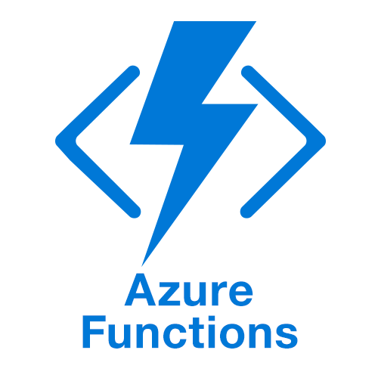
Scaling Model
Notes:
Support elastic, and granular scale

Slide 29
Monitoring/Logging/Troubleshooting

Slide 30
Event Driven Architecture
An Event is represents something that happens in a domain
Customer Submits Order
Customer Billed
Payment Received
Order Ready for Shipment
Order Shipped
While Events and their payload are designed at the enterprise system level, their implementations are left to the specific subsystems.

Slide 31
Event Driven Architecture - Business Capability
Dynamic scaling
Speed to market
Governable
Workflow
Analytics
Notes:
Trade application complexity for infrastructure complexity

Slide 32
Event Driven Architecture - Technical
No point-to-point integrations
Loosely coupled, highly scalable systems
Loosely coupled, TEAMS
Easier to test
Easier to change
Technology agnostic
Notes:
Trade application complexity for infrastructure complexity

Slide 33
Event Driven Architecture - Team
Developer centric
Team skills
Incremental Implementation
Non-invasive
Admininsterable
Notes:
Trade application complexity for infrastructure complexity

Slide 34
Composition

Slide 35
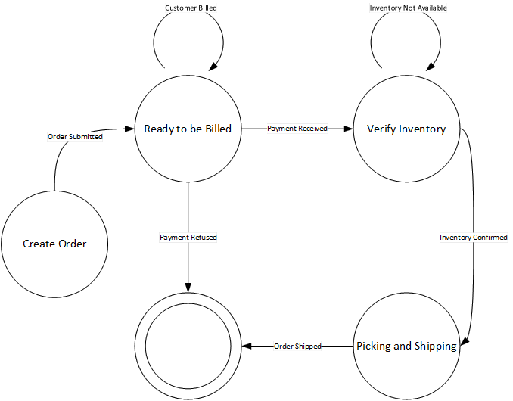
Easily Modeled as a finite state diagram
Notes:
I’m hesitant to keep recommending this. I still think it provides value.

Slide 36
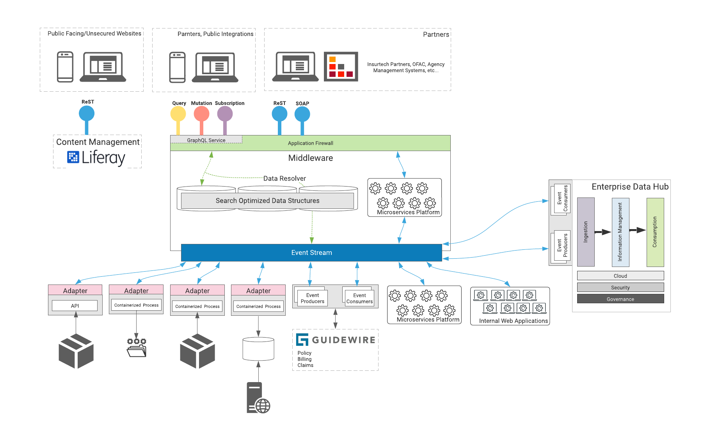

Slide 37
API Gateway

Slide 38
Function as a Service
Client
Client
Client
Api Gateway
Function
Function
Function
Orchestration

Slide 39
Function as a Service
Client
Api Gateway
Function
Function
Function
Orchestration
Notes:
How should the applications functions talk to each other?

Slide 40
Function as a Service
Client
Api Gateway
Function
Function
Function
Event Stream

Slide 41
Event Stream

Slide 42

Loosely Coupled
Orders
Invoicing
Inventory
Event Stream
Logging
Profiles
Reporting

Slide 43
Easy to Integrate New Systems
Orders
Invoicing
Inventory
Event Stream
Logging
Profiles
Reporting
New System
Notes:
Add a new subsystem and start consuming events that are already in the system

Slide 44
Scales
Inventory
Inventory
Inventory
Orders
Invoicing
Inventory
Event Stream
Logging
Profiles
Reporting

Slide 45
Addresses “Data in Motion”
Orders
Invoicing
Inventory
Event Stream
Logging
Profiles
Reporting
Business Intelligence/Data & Analytics
Notes:
BI consumes events

Slide 47
The basic thesis of this article is that organizations which design systems (in the broad sense used here) are constrained to produce designs which are copies of the communication structures of these organizations.
--- Melvin Conway
Notes:
Do our software systems do not create friction in the organization

Slide 48
Other benefits
Ease of 3rd party integration
Existing systems can be ‘wrapped’
Can be deliberate about scaling
Fault tolerant
Event messages can be logged and ‘replayed’
Can test subsystems in isolation

Slide 49
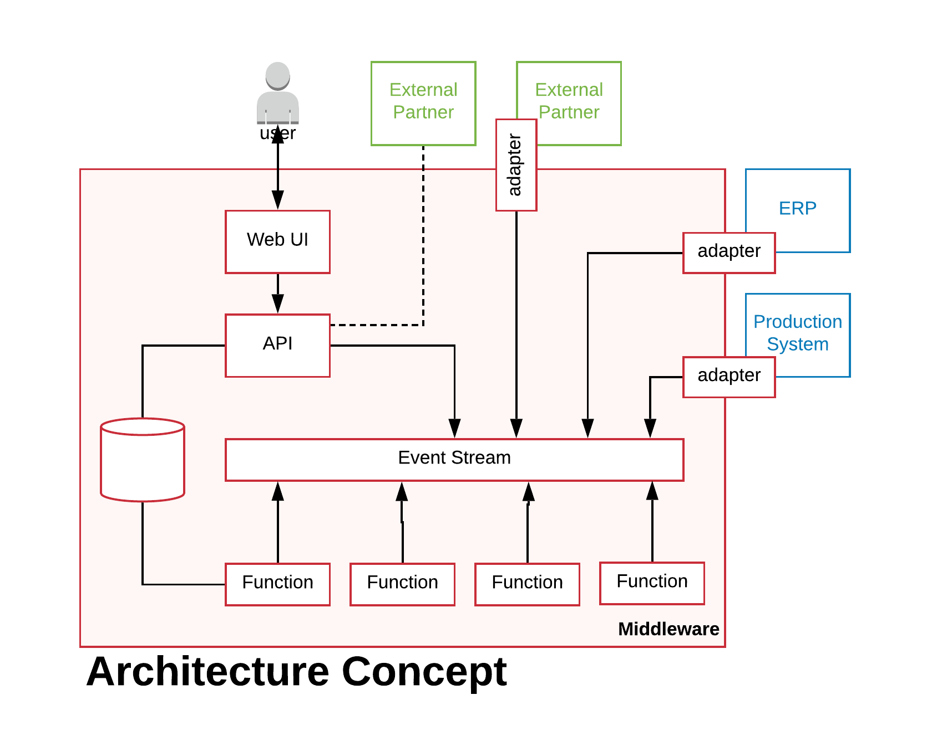
A Retail System

Slide 50
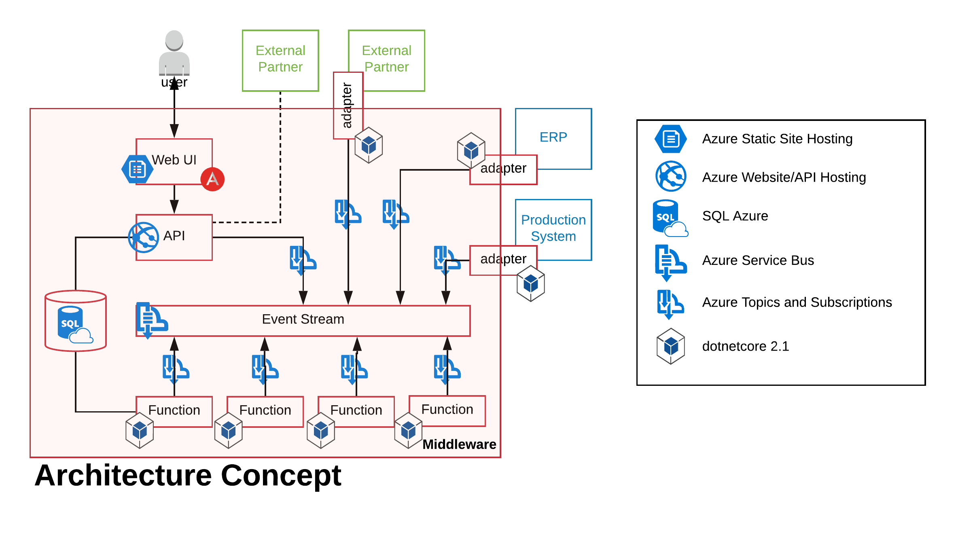
A Retail System

Slide 51
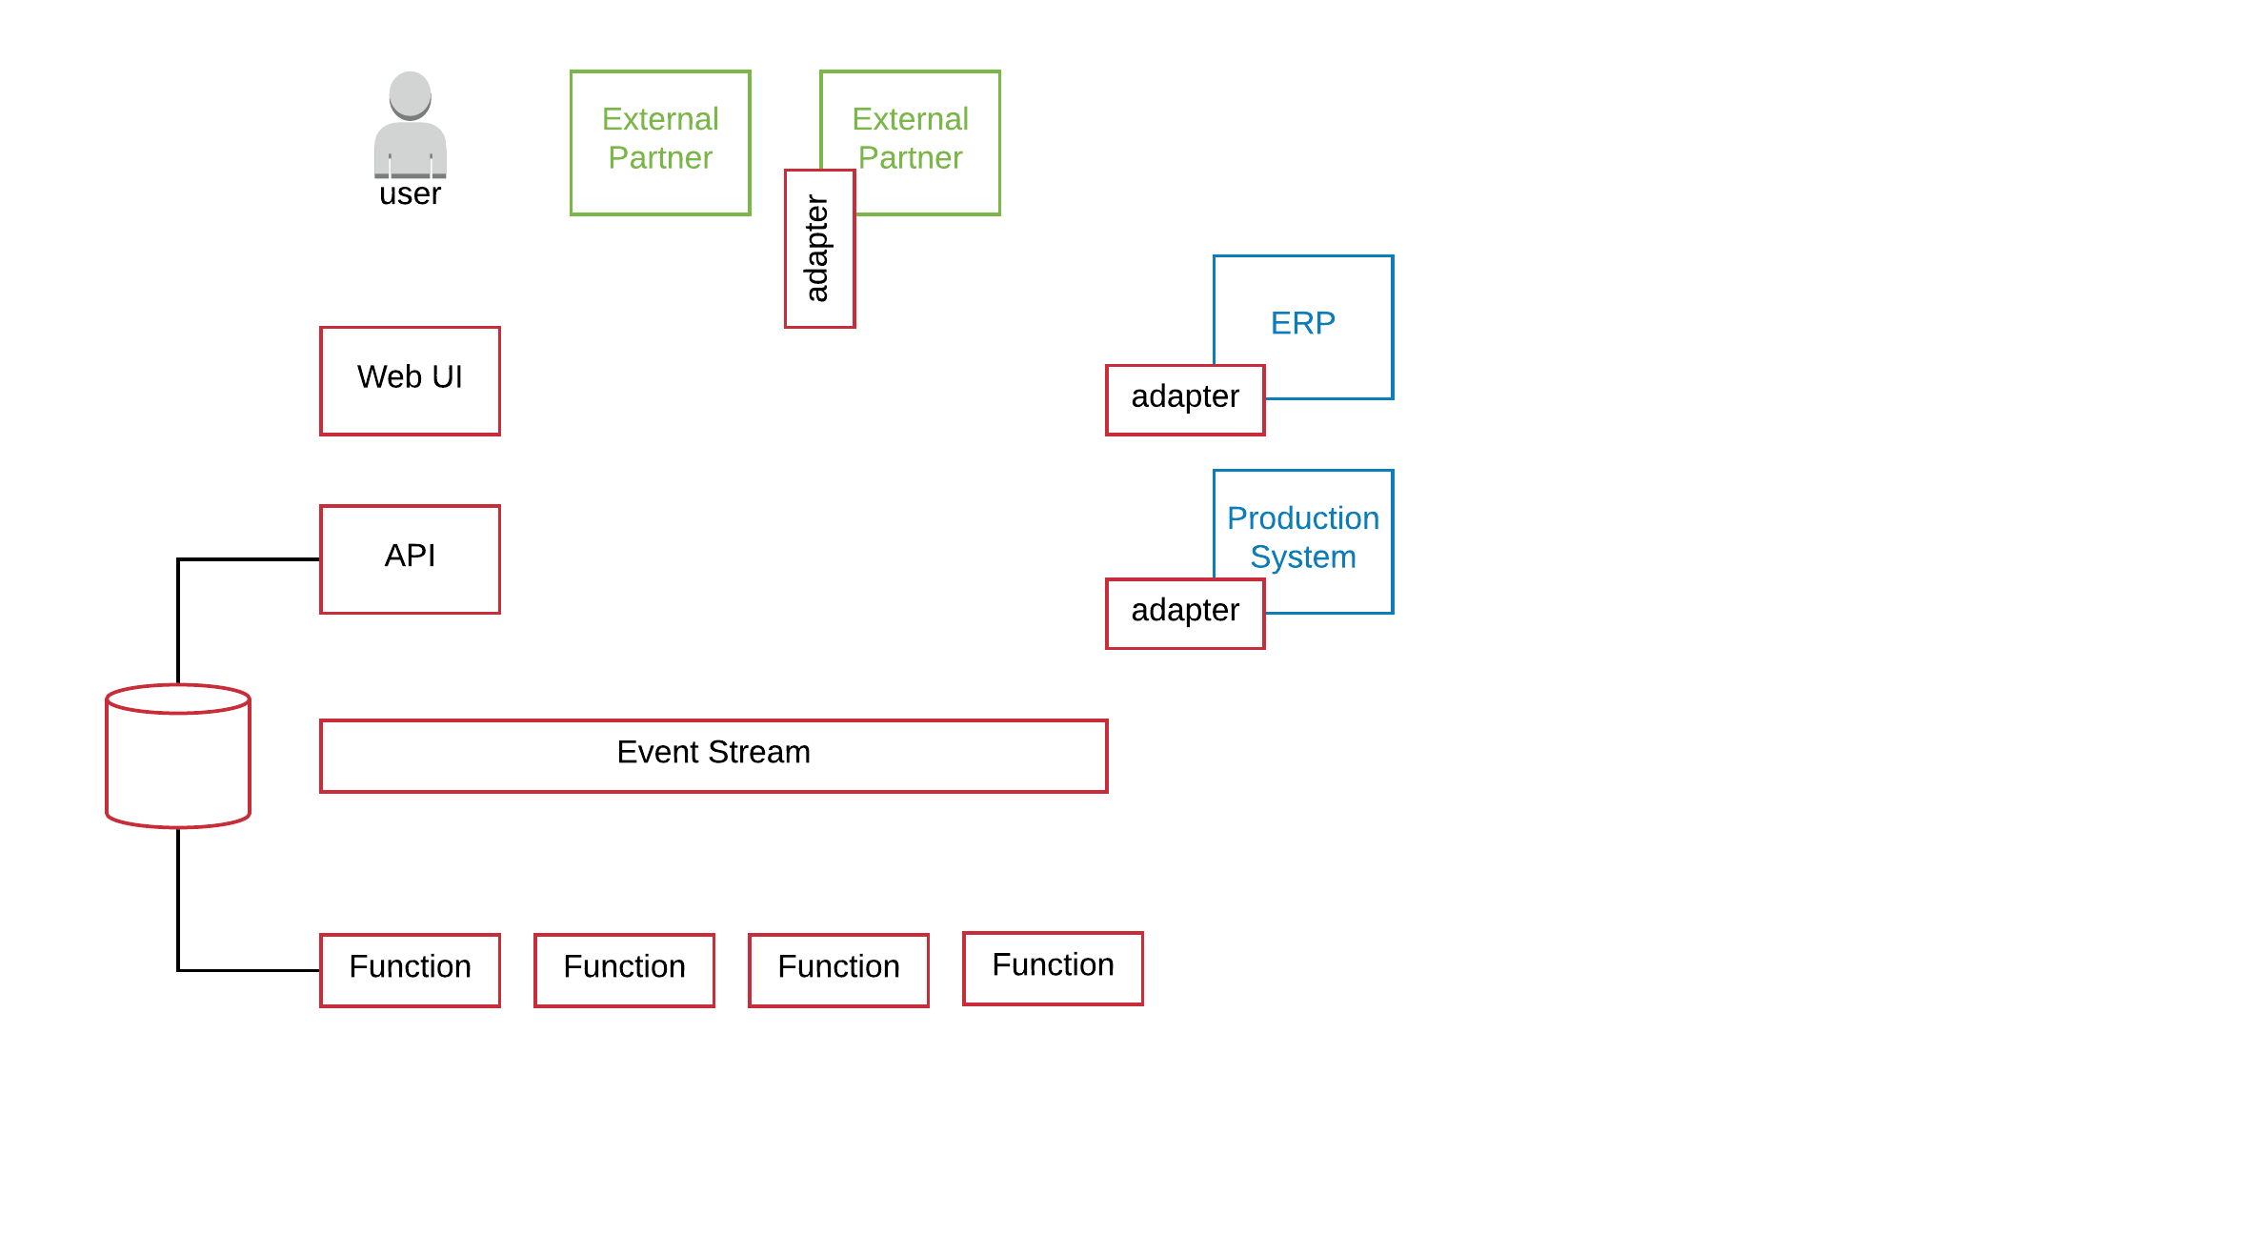

Order Created Event is generated by a User
Invoicing
Shipping
Warehouse
Logger

Slide 52
Customer Billed Event
Invoicing
Shipping
Warehouse
Logger

Slide 53
Item Produced Event
Invoicing
Shipping
Warehouse
Logger

Slide 54
Order Shipped Event
Invoicing
Shipping
Warehouse
Logger

Slide 55
The Logger consumes EVERY event
Invoicing
Shipping
Warehouse
Logger

Slide 57
Event Sourcing

Slide 58
Event Sourcing
Events are immutable
Events describe the action
Eventually consistent data
Embraces CQRS

Slide 59
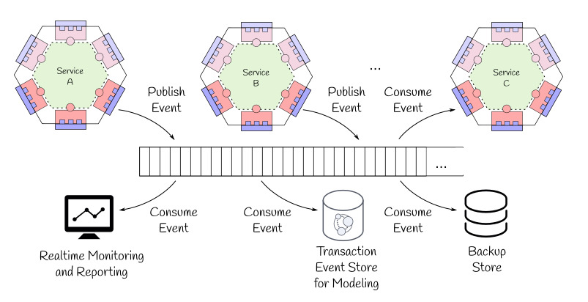
Event Sourcing
Image via: Microservices with Clojure
Notes:
This concept has promise, I’m not good at it yet.

Slide 60
For Further Reading
THIS presentation (and code) on GitHub
https://github.com/shawnewallace/eda-rabbitmq
Stephan Norberg EDA
http://www.infoq.com/presentations/Domain-Event-Driven-Architecture
“Programming Without a Call Stack”
http://www.enterpriseintegrationpatterns.com/docs/EDA.pdf
“Event-Driven Architecture Overview”
http://www.omg.org/soa/Uploaded%20Docs/EDA/bda2-2-06cc.pdf
“…Event Sourcing is Hard”
https://chriskiehl.com/article/event-sourcing-is-hard

Slide 61
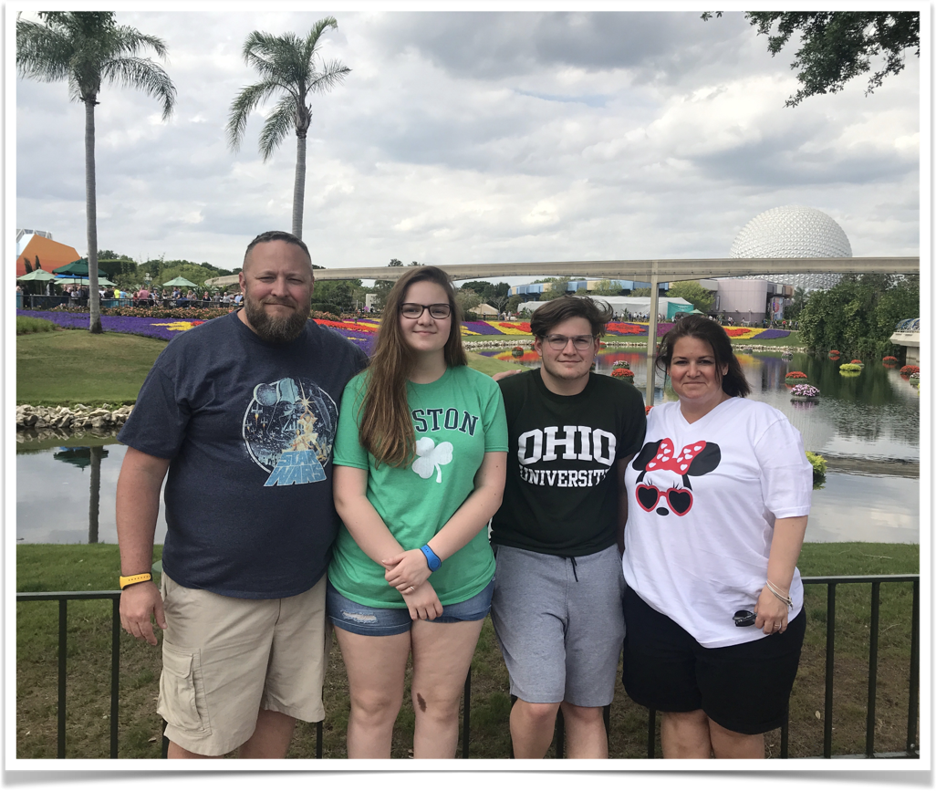
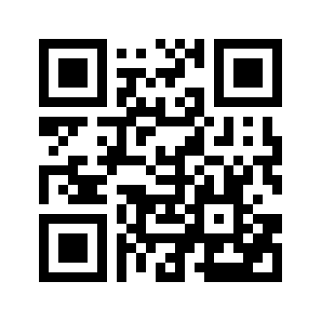
Shawn Wallace

Slide 62
Event-driven architecture is a versatile approach to designing complex software systems. These systems tend to be easier to model for an organization as EDA embraces Conway’s Law and can often be modeled as a finite state machine. Event-driven architecture is not a new concept, but as more organizations embrace micro services, this approach to system design has become appropriate in more situations. In this talk we’ll: introduce event-driven architecture, talk about key components, look at a sample implementation of a retail system.

